Slide 1
Data Visualization for Environmental Epidemiology with ggplot2
Mastering Presentation Grade Figures
ISES 2021 Pre-Conference Workshop
August 6, 2021
Disclaimer: The views expressed in this workshop are those of the authors and do not necessarily reflect the views or policies of the USEPA. Mention of trade names or commercial products does not constitute endorsement or recommendation for use.

Slide 2

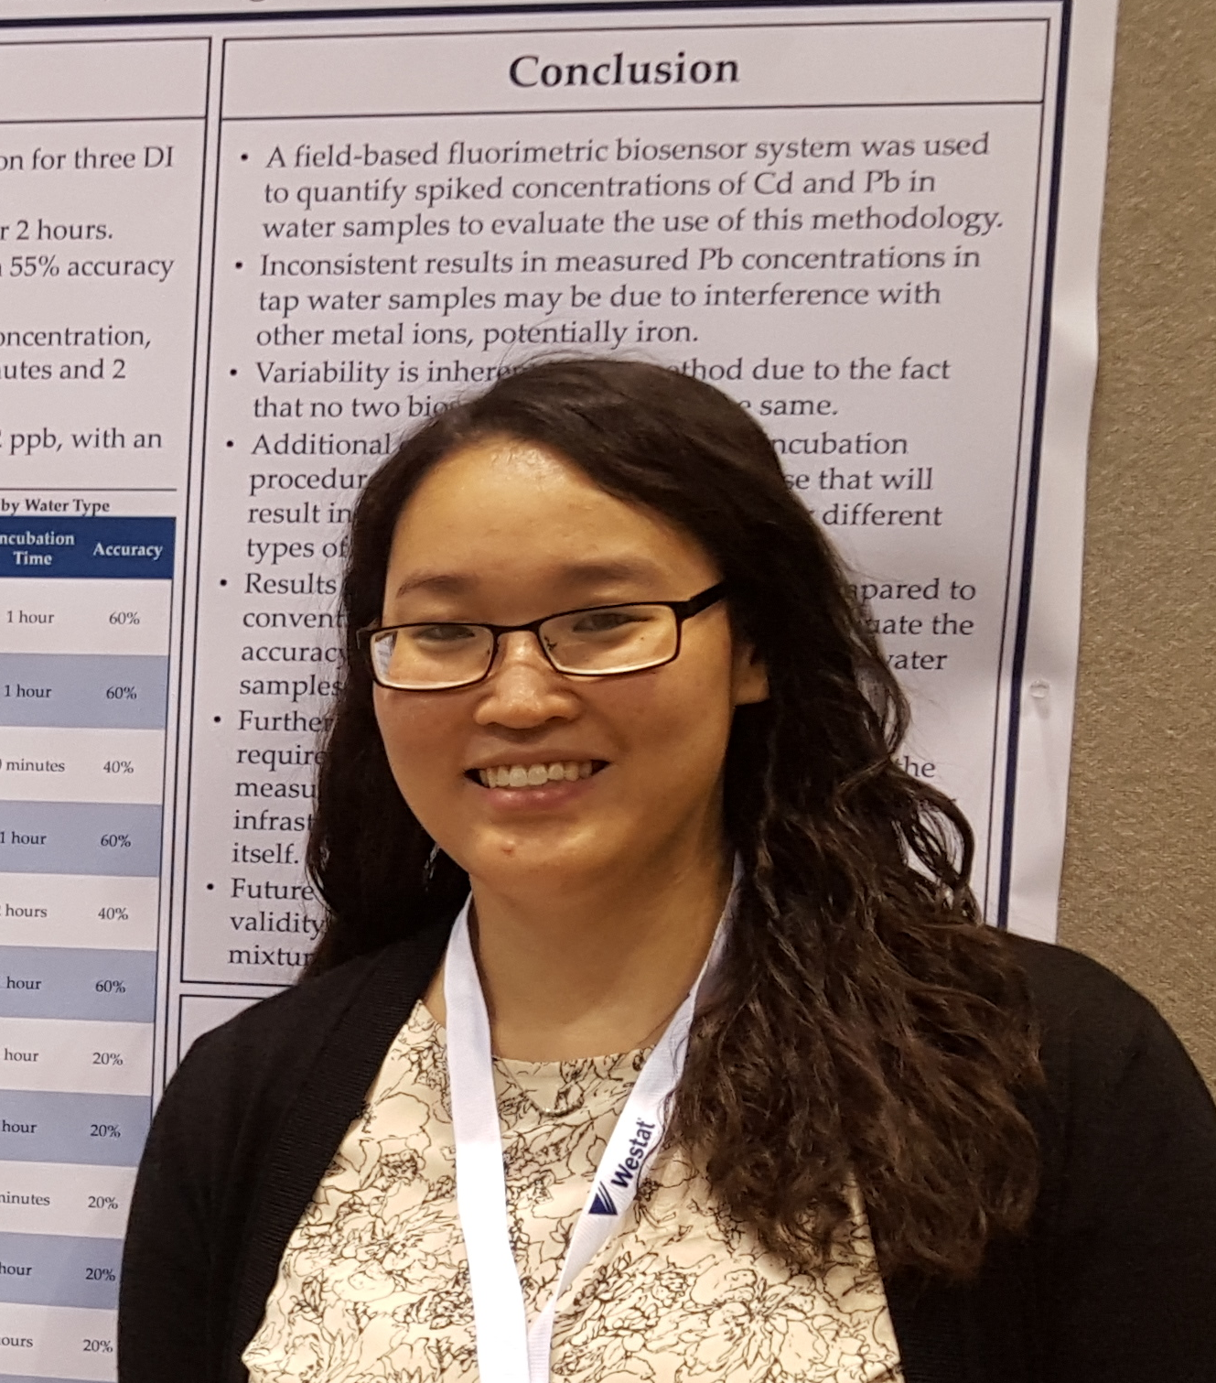

Welcome!
Alexandra Larsen, Ph.D.
US EPA | ORD | CPHEA | CPAD | TEAB-D
Alison Krajewski, Ph.D.
US EPA | ORD | CPHEA | HEEAD | IHAB
Lauren Wyatt, Ph.D.
US EPA | ORD | CPHEA |
PHITD | CRB

Slide 3
Workshop Format
3x 50-minute sessions with 10-minute breaks in between.
Code examples in RStudio throughout.
All presentation materials are on GitHub:
https://github.com/USEPA/data-viz-ggplot2
Please feel free to ask questions!

Slide 4
Topics for Today
Section 1: What makes a “good” figure?
Section 2: The Basics (i.e. data formatting and ggplots)
Section 3: Customization (i.e. scales, colors, theme and facets)
Section 4: Complex plots (i.e. maps, examples)
Notes:
Animate colors?

Slide 5
Section 1
What makes a “good” figure?

Slide 6
Characteristics of Effective Plots
Graph type is appropriate for the data/results;
Scales are correctly formatted;
Message is clear enough to understand in a few minutes;
Formatting choices deliver the message instead of distract from it;
Facilitates informed decision-making.
Milnes, Jason. “Effective Visualizations for Credible, Data-Driven Decision Making.” Rstudio Blog. Apr. 2020.
Notes:
We will use this as a guide for each plot we make in this workshop.
[Add colors??]

Slide 7
‘Flatten the Curve’
Image Credit: National Public Radio (NPR), Centers for Disease Control (CDC).
Notes:
Graphic being used by media outlets and health care system to communicate to lay people the impact of implementing protective measures on the health care system
Only takes a minute or two to digest the information here
Because:
Everything is labeled clearly – the axes, the curves, even the dotted line
Colors are used to draw attention to the comparison they want you to make

Slide 8
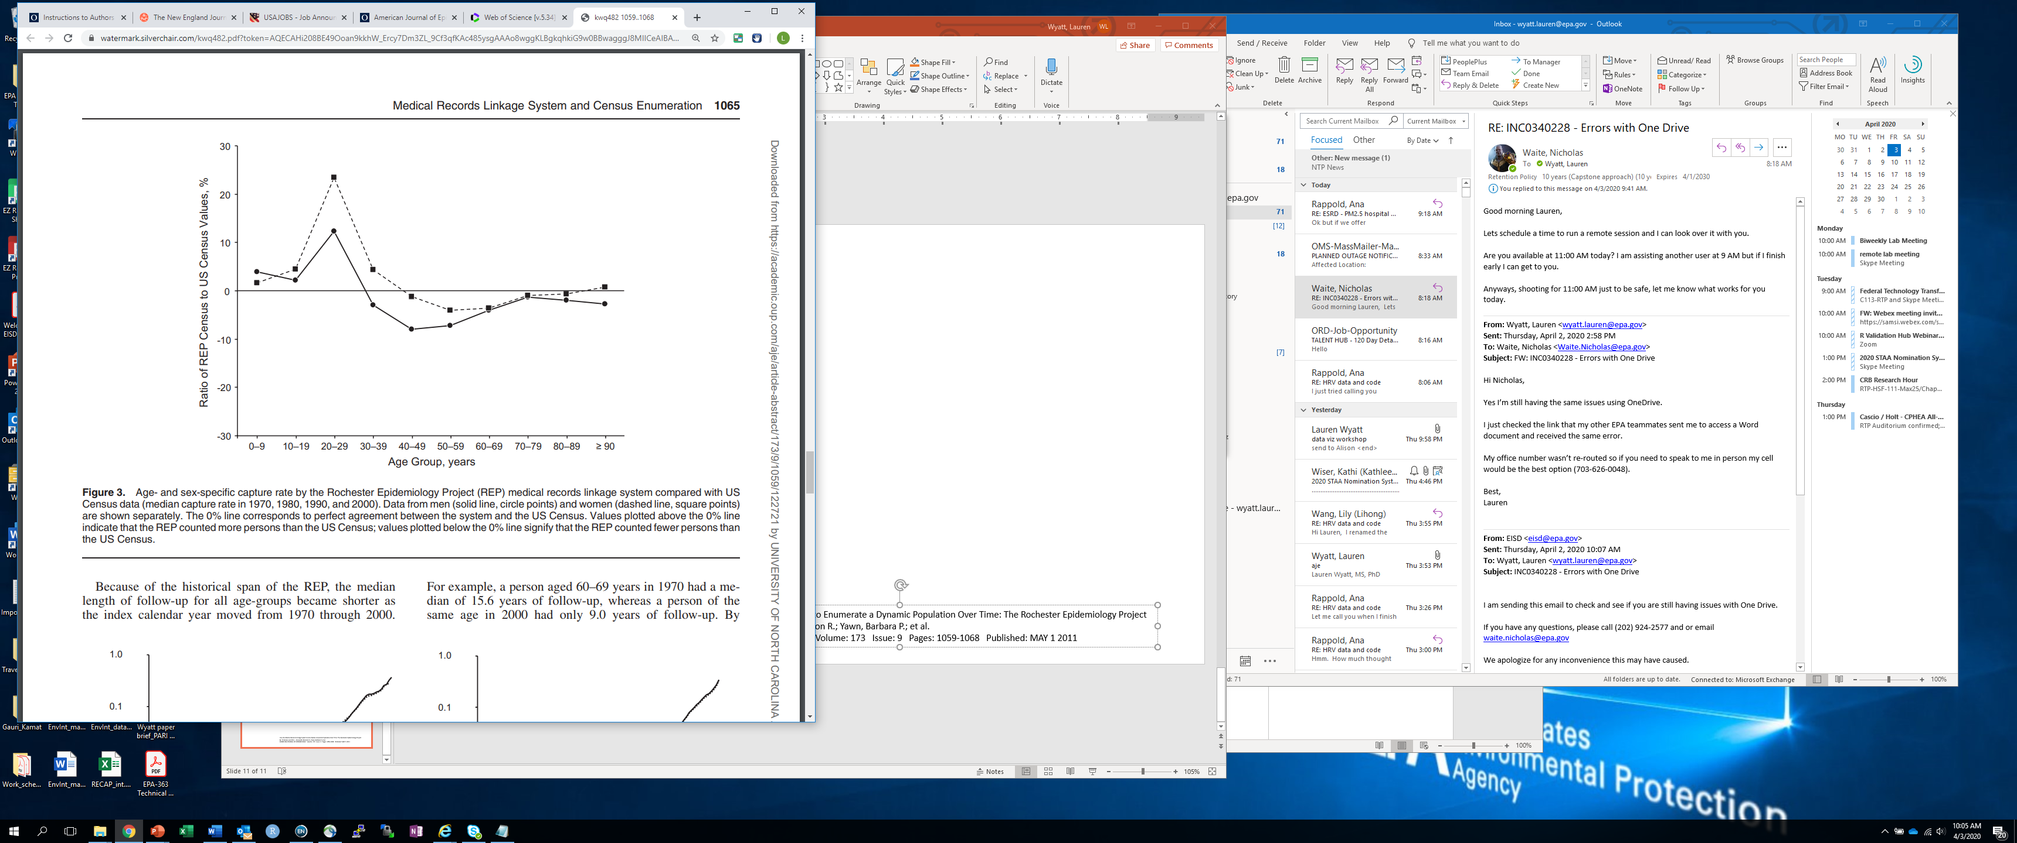
From the Literature:
St Sauver, Jennifer L.; Grossardt, Brandon R.; Yawn, Barbara P.; et al. Use of a Medical Records Linkage System to Enumerate a Dynamic Population Over Time: The Rochester Epidemiology Project. AMERICAN JOURNAL OF EPIDEMIOLOGY Volume: 173 Issue: 9 Pages: 1059-1068 Published: MAY 1 2011
Notes:
Minimal graph elements make it easy to read
Axes are clearly labeled and the units are included
All abbreviations are defined
The line types are explained and they help facilitate the message of the graph, which is to highlight the difference between men and women.
Line type is easily distinguishable
Simple graph, but effective and clear

Slide 9
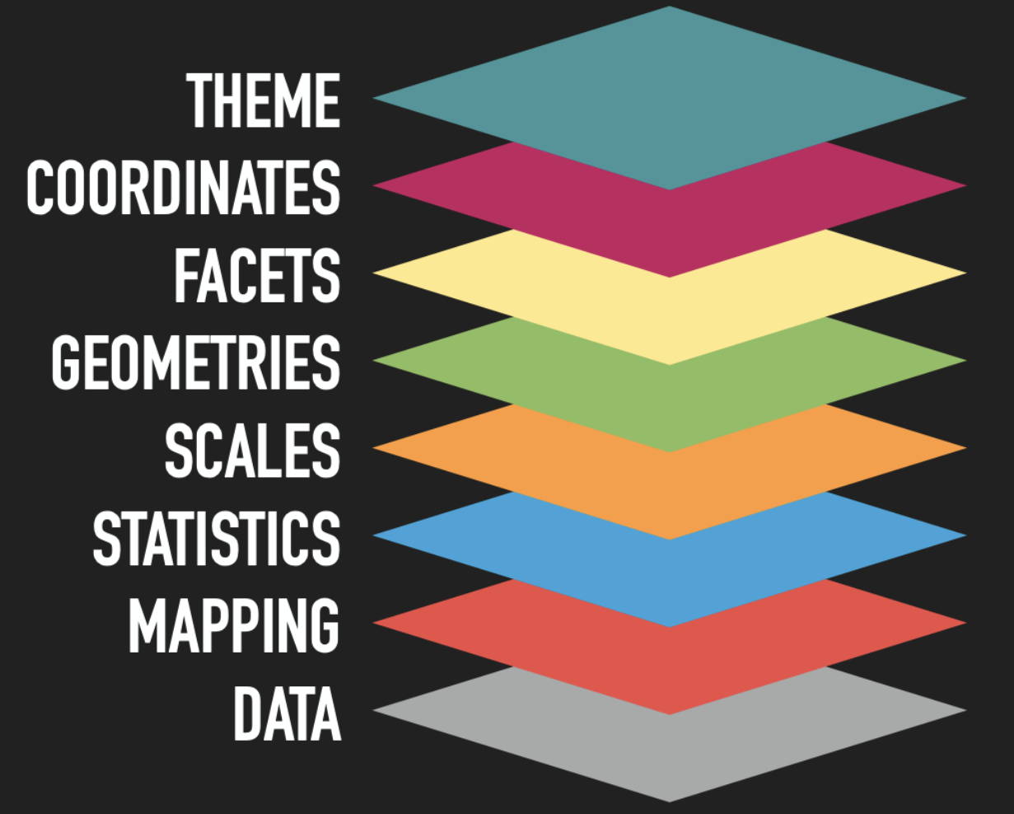
ggplot2
Open-source R package for making scientific graphics.
“ggplot” = Grammar of Graphics (Leland Wilkinson).
Links variables in any data set to graphic components.
Allows for more flexibility and customization than built-in plots.
Lin Penderson, Thomas. “Plotting Anything with GGPlot2.” celebRation Workshop. 2020.
Notes:
- Instead of built in types of plots, ggplot2 is a platform for creating graphics.

Slide 10
Section 2
The Basics: data formatting and ggplots.
Notes:
Goal: be able to open RStudio, read in data, create a figure with the default settings, save it

Slide 11
Data Formatting

Slide 12
Importing and Exporting Data Sets in R
R works with several data formats (e.g. .xlsx, .txt); .csv is easy and user-friendly.
To import .csv files, use read.csv():
Include the name and location of the .csv file, whether there are headers, etc.
Assign imported file to a variable name; it becomes a ‘data.frame()’ object.
To export .csv files, use write.csv():
Include the data frame object, the file name, the name of the destination, whether to include headers, etc.
For other data formats, the import/export functions in R typically follow the format,
{read/write}{_/.}{extension type},
But there are several formats, many of which are included in the examples…
Notes:
mention: fread() – better for larger data sets
read_csv()

Slide 13
Data Manipulation with tidyr
Tidyr is a library for data cleaning.
Includes intuitive functions for sub-setting, pivoting, etc.
Both ggplot2 and tidyr use the pipe operator:
f(object, args) == object %>% f(args)
Allows for streamlined code that is easy to read.
The pipe operator is “%>%” in tidyr and “+” in ggplot2.
Notes:
SKIP example

Slide 14
Long vs. Wide Data
Often need to convert between long and wide data.
Long (narrow, stacked):
One columns contain the values, and the other contains the description. Going from wide to long lengthens the data, increases the number of rows.
Wide:
Each variable in the data has its’ own column. Going from long to wide shortens the data. Very useful format for plotting.
Go to Example…

Slide 15
ggplots
Notes:
Basics: ggplot() + geom_{plot_type}, data, map variables to data set

Slide 16
Basic Structure
ggplot(data = dat.csv) +
geom_point(aes(x, y, shape, lty))+
geom_hline(y = 0) +
theme_bw() +
ylim(c(-30, 30)) +
ggtitle(null)
xlab(”Age Group, years”) +
ylab(“Ratio of REP Census…”) +
scale_line_manual(guide = F) +
scale_shape_manual(guide = F)
Geometries
(Plot type)
v
Themes
(background, style)
Labels, Axes
(breaks, limits etc.)
Scales, Legends
(Controls the aesthetics)
Notes:
pseudo-code for the the figure that we saw earlier
Ggplots are constructed with a series of layers
Each component of the graphic is controlled by a different chunk or layer of code
The first starts the plot and brings in the data
Next, we have code that controls the geometries, or plot type
We’ll get into the syntax later, but …
Lines
Horizontal line
Next we have code that controls the theme of the plot, or Background, style
Next, labels and axis
Explain code
Finally scales and legends – the scale functions in ggplot control the aesthetics of the plot and are one way to create legends
For the lines, we could make them different colors, same for the shapes
No legend
Going to go into detail on geometries, themes, labels and scales for the rest of the talk and hopefully by the end, this code will be familiar to you

Slide 17
Creating a ggplot
Starts with a call to ggplot(), add graphic components in layers.
E.g. plot type, scales, theme, etc.
In each component, specify data set and map aesthetics to the data.
Aesthetic mapping: links variables in data to graphic component (e.g. x, y, color, shape, etc.)
Data sets must be a data.frame() type, not numeric(), matrix(), etc.
ggplot2 Reference. https://ggplot2.tidyverse.org/reference/
Notes:
Identify which we’ll be talking about today.

Slide 18
Plot Types and Geometries (geoms)
geom_{plot-type}()
Controls the points, lines, bars, polygons that go into making each type of plot
Commonly used:
geom_point (scatterplot)
geom_histogram (histogram)
geom_boxplot (box plot)
geom_map (maps)
Comprehensive list: ggplot2 Reference page
Go to Example…
ggplot2 Reference. https://ggplot2.tidyverse.org/reference/
Notes:
- Add screen shot of the reference page instead (link in the reference below)

Slide 19
Saving Figures
ggsave()
Defaults to saving the last plot created; call immediately after making your figure.
Can specify figure dimensions, resolution (dpi), format.
Several output formats (png, jpg, tiff, etc.)
grid.arrange(), multiplot(), ggarrange()
Combine multiple plots into one figure (alternative to facet)
Go to example…
Notes:
Examples in the markdown…

Slide 20
Section 3
Customization: Scales, colors, theme, and facets.

Slide 21
Scales

Slide 22
Scales
What are they?
Controls the mapping from data to aesthetics
Everything inside the aes() will have scales
Each scale is a function from a region in data space (domain of scale) to a region in aesthetic space (range of scale)
Wickham H. ggplot2: Elegant Graphic for Data Analysis. New York: Springer-Verlag; 2009.
Notes:
Scales control the mapping from data to aesthetics
They provide the tools that let you interpret that plot – the axes and legends
You can generate many plots without knowing how scales work, and use the defaults, but understanding scales and learning how to manipulate them will give you much more control
Scales can be divided into the main categories of:
Position scales are used map the data to the x and y position
Color scales are used to map continuous and discrete data to colors
Manual scales are used to map discrete values to the specified choice of size, line type, shape, or color

Slide 23
Modifying Scales
Scales are made up of three pieces separated by an underscore (_)
Scale + name of aesthetic (e.g. colour, shape, or x/y) + the name of scale (e.g. discrete, continuous, brewer)
Examples:
scale_x_continuous()
scale_color_discrete()

Slide 24
Labels
x and y axes labels will default to the variable name
Modify the scales to change the label
scale_x_continuous(name=“Label Name”)
ylab(“Label Name” )
Labels can include superscript, subscript, and mathematical expressions

Slide 25
Breaks
Breaks control which values appear as tick marks on axes and keys on legends
Breaks can be set on continuous or categorical scale
Used for labels, colors
Notes:
Breaks controls which values appear as tick marks on axes and keys on legends
If you set labels argument, then you must set breaks argument
If the data changes, the breaks will no longer align with the labels
Breaks can be set on continuous or categorical scale
Categorical scale can use a named label vector
Example: scale_y_discrete(labels=c(a=“alpha”, b=“beta”))
Hint: To suppress breaks (for axes or grid lines) or labels, set them to NULL
MARKDOWN – the first example shows how to specify the x and y label name from the default for the variable name
This option uses scale_x_continuous and scale_y_continuous
The second option uses the xlab and ylab option
MARKDOWN – you can also label the axes with mathematical expressions or with subscripts and superscripts.
In Markdown, you can also modify the limits by using the limits=c() function within the scale
MARKDOWN – you can create breaks using the breaks=c() within the scale as well
MARKDOWN - the hypertension examples is first shown with the defaults, and no modification to the scales for breaks.
In the second example, the x-axis has been modified, so that the breaks are created based on the labels for the two-letter state abbreviation

Slide 26
Legends
Legends can display multiple aesthetics (color, shape), from multiple layers
Symbols displayed in legend varies based on the geom() used in layer
Legends have more details that can be manipulated
Vertically or horizontally
Columns or rows
Size
Go to code and examples in markdown
Notes:
Legends can be a helpful component in displaying results
Legends can be modified like the break and labels

Slide 27
Colors

Slide 28
Colors
Continuous
Note: for continuous color scales, keep the color scheme constant, and use a gradient scale
scale_colour_gradient() or scale_fill_gradient()
scale_color_distiller() or scale_fill_distiller()
Discrete
Note: for discrete color scales, keep the color scheme color blind friendly
scale_colour_brewer()
Uses “ColorBrewer” colours (https://colorbrewer2.org)
scale_colour_grey()
Helpful for when needing grey-scale figures
scale_colour_manual()
Notes:
For continuous scales, keep the color scheme constant, and use a gradient scale
For discrete color scales, keep the color scheme color blind friendly

Slide 29
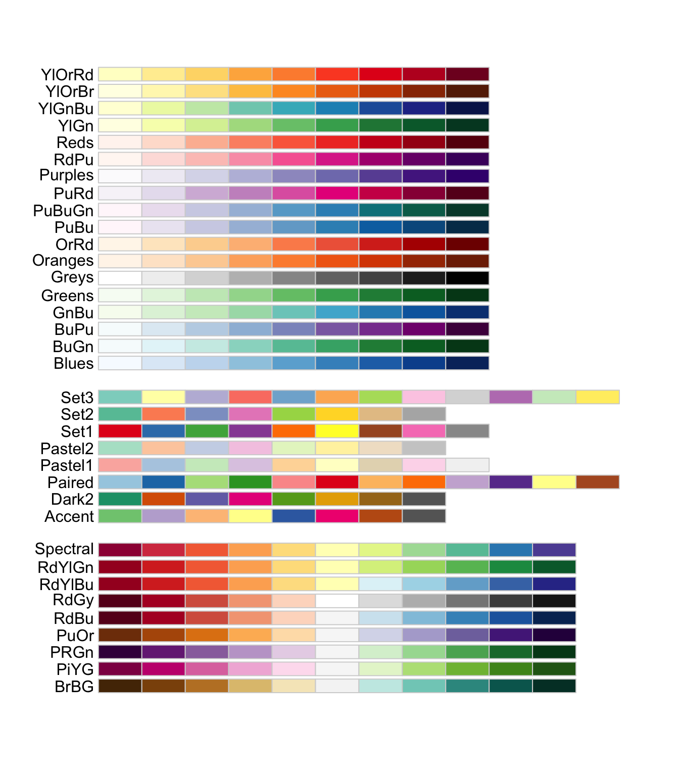
ColorBrewer
Sequential
Qualitative
Divergent

Slide 30
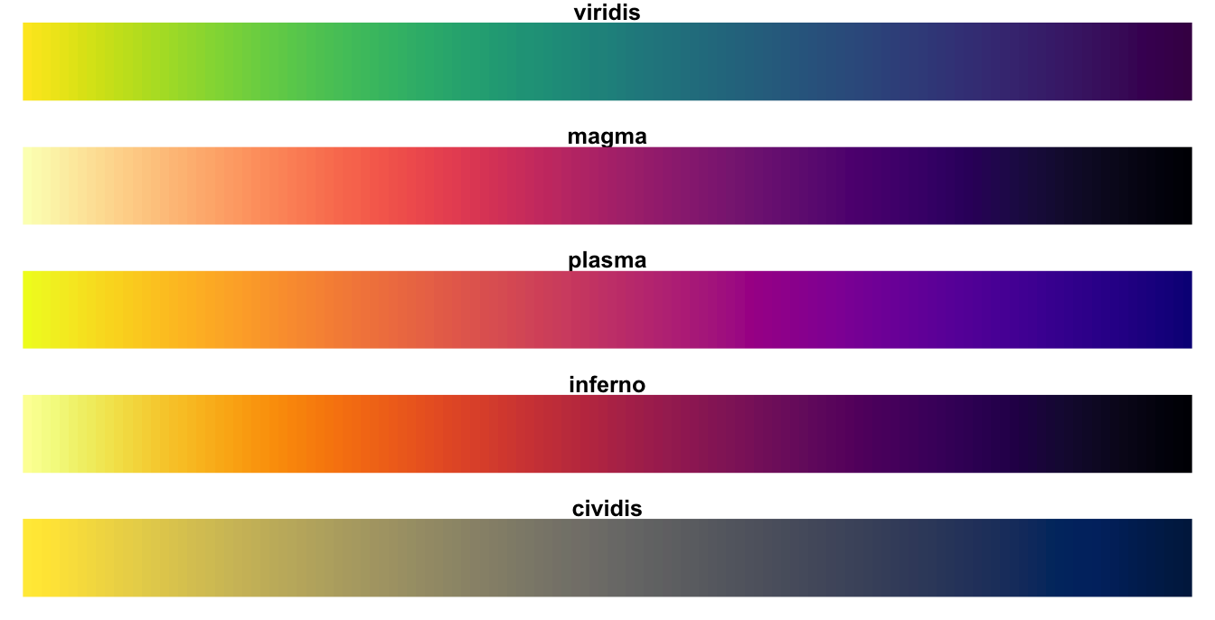
Viridis

Slide 31
Creating Color Palettes
Use breaks to create color palette
Can use pre-existing color palettes
Specify in scale_color_brewer()
Create a color palette with HEX codes
First, create a set of values
Second, specify with scale_color_manual
Go to code and examples in markdown

Slide 32
Theme

Slide 33
Theme
What is a theme?
Pre-existing themes
Naming convention
Customizing plot example

Slide 34
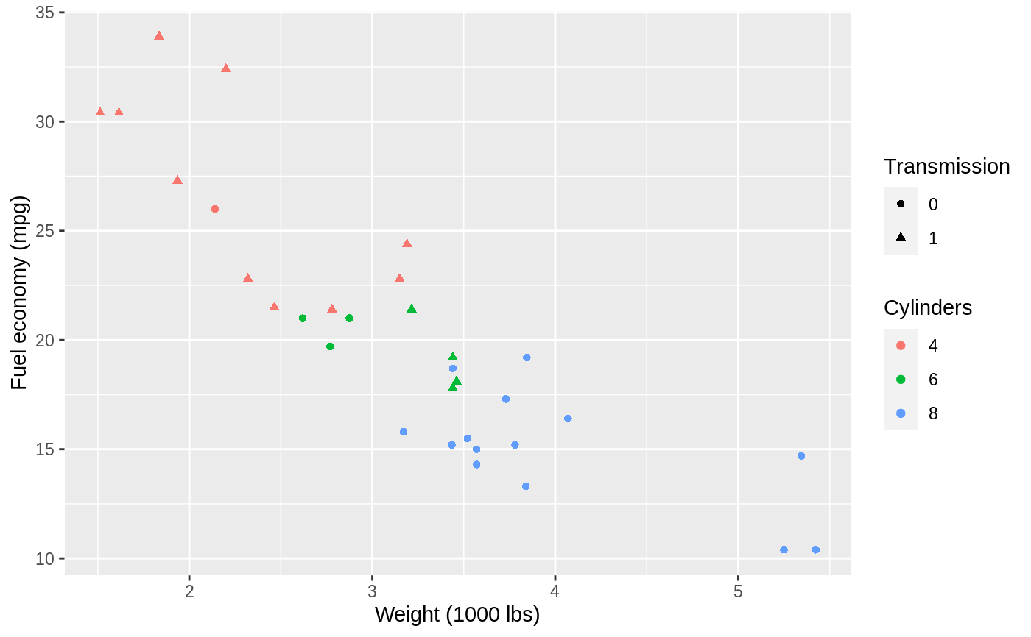
Theme
Customize non-data part of plots
Titles, labels, fonts, background, gridlines, legends
Data exploration → Polished figure w/ focused message
Notes:
What is a theme
Reference: Components of theme - https://ggplot2.tidyverse.org/reference/theme.html

Slide 35
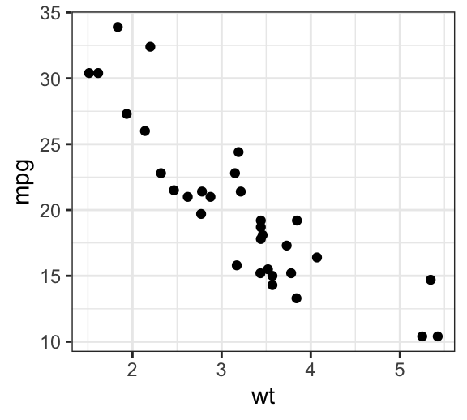
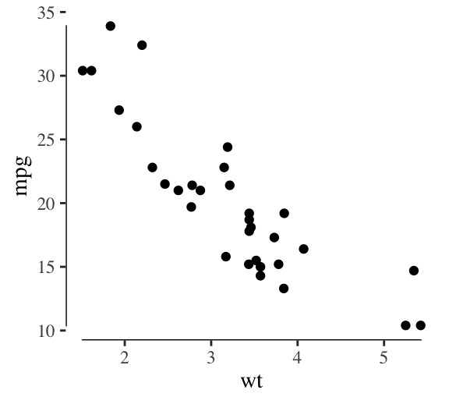
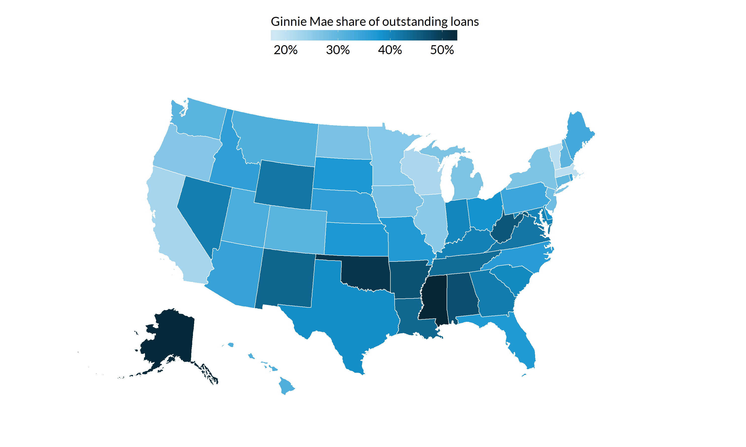
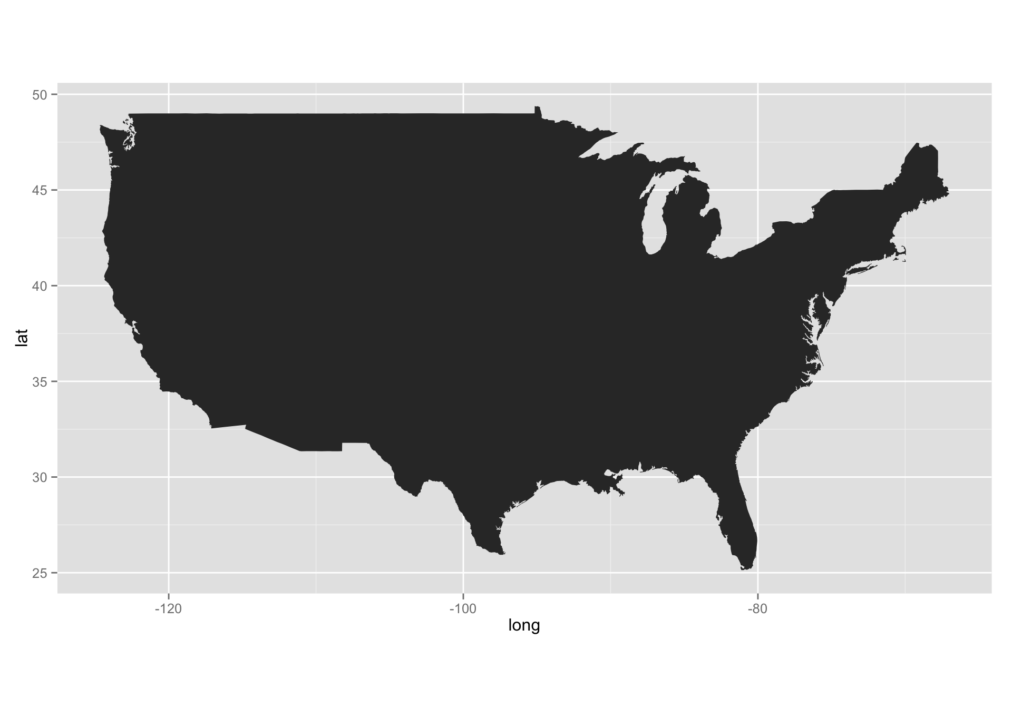
Use theme to focus attention to data
Choosing – decluttering
Maps – remove plot borders

Slide 36
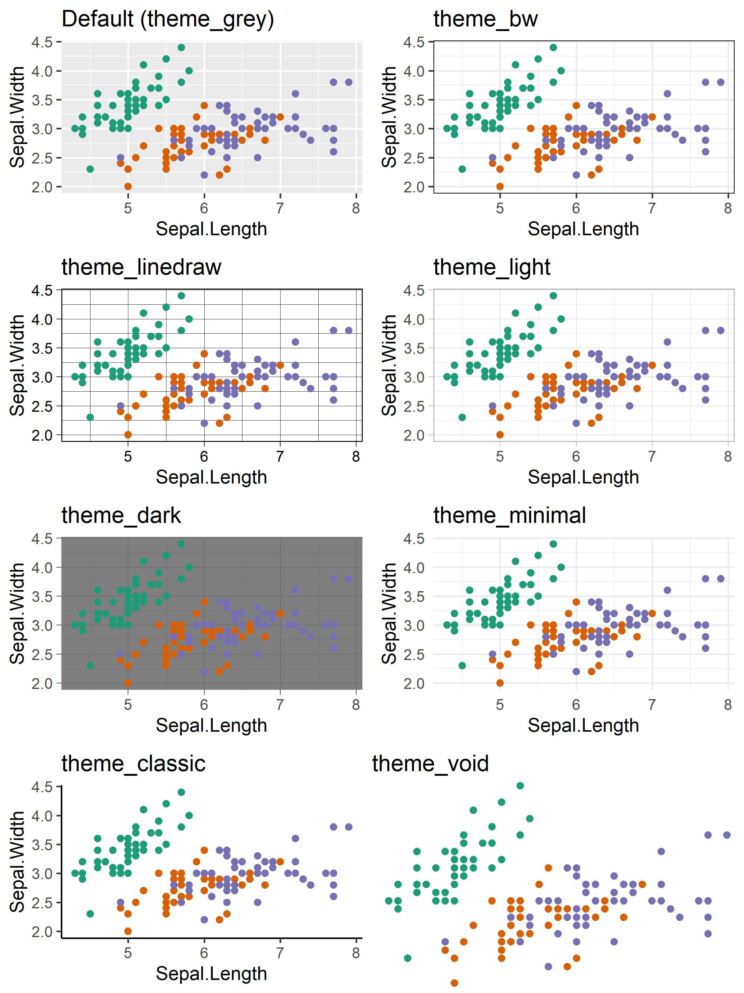
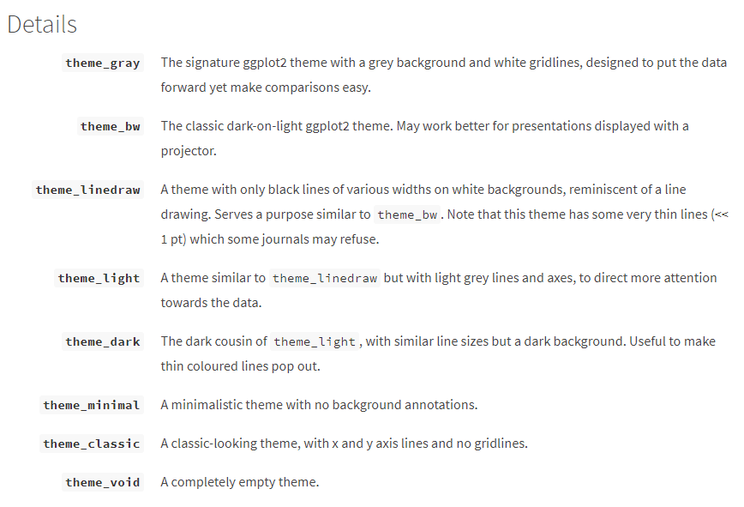
Pre-existing themes
Great place to start, can customize further with theme()
Notes:
https://ggplot2.tidyverse.org/reference/ggtheme.html
Also package “ggthemes”

Slide 37
Custom theme – theme()
Main components
Line elements
axis lines, minor and major grid lines, plot panel border, axis ticks, etc.
Text elements
plot title, axis titles, legend title and text, axis tick mark labels, etc.
Rectangle elements
plot background, panel background, legend background, etc.
Functions
element_line(color, size, linetype)
element_text(face, color, size, hjust, vjust, angle)
element_rect(fill, color, size, linetype)

Slide 38
Custom theme
Naming convention
General
theme( axis.text = element_text(size = text_size) )
More specific
theme( axis.text.x = element_text(size = text_size) )
Change text size for all text
Change text size for only x-axis
Notes:
https://ggplot2.tidyverse.org/reference/theme.html

Slide 39
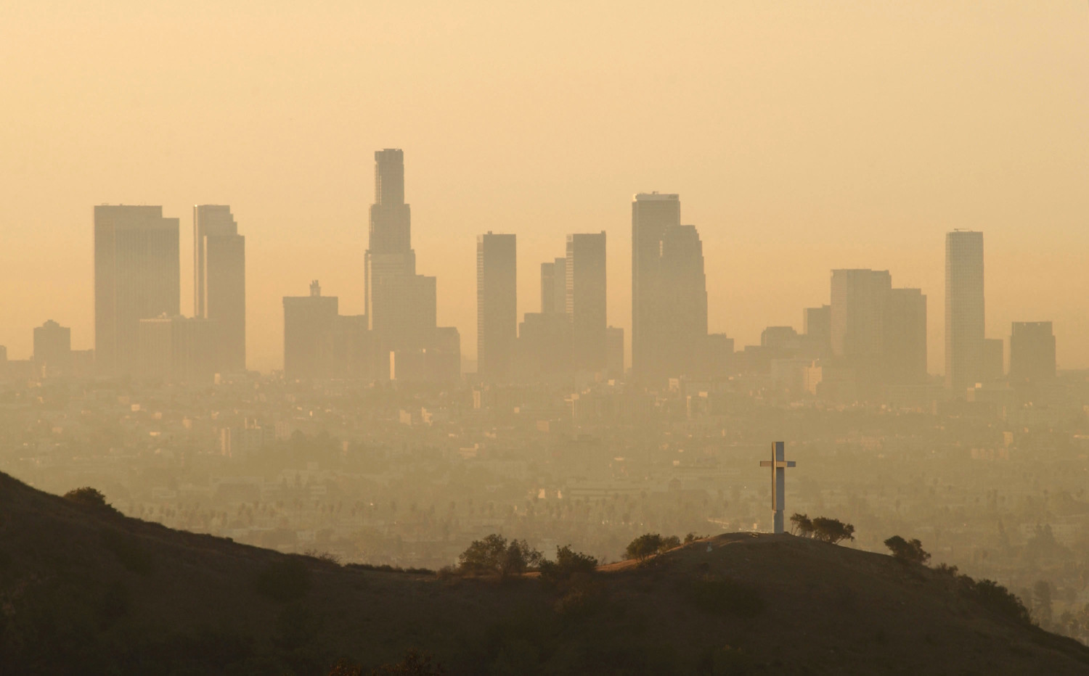
Theme example with scatterplot
Data
Daily ozone measurements in 2 cities
Time series
Source: Los Angeles Ozone Pollution Data, 1976 (package: mlbench)
Improvements
Gridlines
Text size
Rotate axis labels
Spacing between panels
Legend position

Slide 40
Facets

Slide 41
Facets
What is it?
Facets generate small groupings with a different subset of the data
Powerful tool for exploratory data analyses
Readily compare patterns in different parts of data to see differences or similarities
Panel layout may carry meaning
Three types
facet_null(): a single plot
facet_wrap(): wraps a ribbon of panels
facet_grid(): produces a grid of panels defined by variables forming the rows and columns
Notes:
Facets can be helpful in comparing patterns.
Just remember that the way that you panel your figures has meaning. Think about what you are paneling together. The figures faceted together should have a commonality.

Slide 42
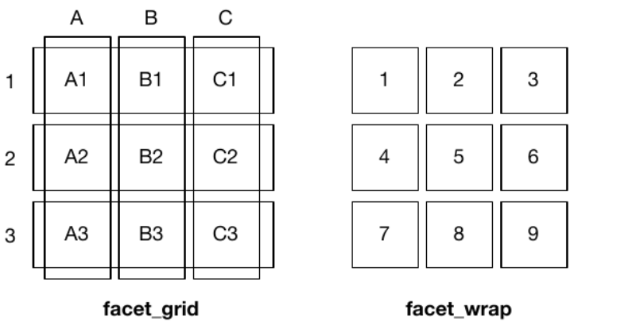
Facet Grid vs. Facet Wrap
Wickham H. ggplozt2: Elegant Graphic for Data Analysis. New York: Springer-Verlag; 2009.

Slide 43
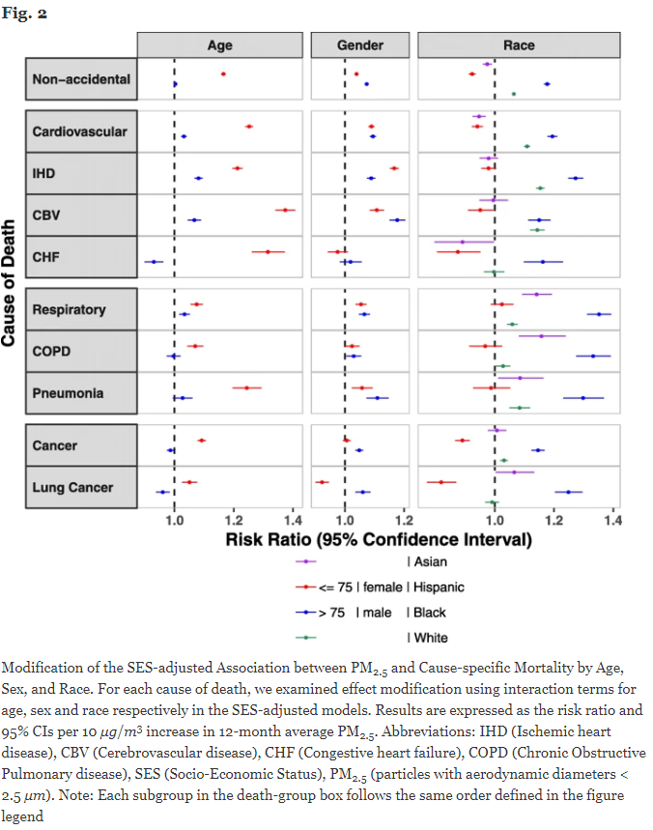
Example from the Literature
Wang B, Eum K, Kazzemiparkouhi F, Li C, Manjourides J, Pavlu V, and Suh H. The impact of long-term PM2.5 exposure on specific causes of death: exposure-response curves and effect modification among 53 million US Medicare beneficiaries. Environmental Health 2020; 19: 20. doi: https://doi.org/10.1186/s12940-020-00575-0
Notes:
Nice separation between facets – example of facet grid
Dual use of colors for labels is confusing
Sex could be symbols, race color
Could also add label info to y axis
Good use of reference line
Colors should be color blind friendly

Slide 44
Facet Grid
Lays out figures in a grid defined by . ~ option
.~a spreads that values of variable a across columns, which allows for comparisons of the y-axis because the vertical scales are aligned
b~. Spreads the values of variable b down rows, which allows for comparisons of the x-axis because the horizontal scale are aligned
a~b spreads variable a across columns and variable b down rows
Usually put the variable with the highest number of levels in the columns
Notes:
Note: Multiple variables in the rows or columns by adding them together a+b ~ c+d

Slide 45
Facet Wrap
Control wrap with: ncol, nrow, as.table, and dir
ncol and nrow controls the number of columns and rows in the arrangement
as.table controls the layout to be like a table, with highest values at the bottom right (as.table=TRUE) or the highest values at the top right (as.table=FALSE)
dir controls the direction of the wrap (horizontal or vertical)
Notes:
MARKDOWN

Slide 46
Scales in Facets
Position of scales can be the same in all panels (fixed) or vary between panels (free)
scales = “fixed”: the x and y axes are fixed across the panels
scales = “free_x”: the x axis is free, but the y axis is fixed
scales = “free_y”: the y axis is free, but the x axis is fixed
scales = “free”: x and y axes vary across the panel
Go to code and examples in markdown

Slide 47
Section 4
Complex plots: Maps, examples from the literature.

Slide 48
Mapping

Slide 49
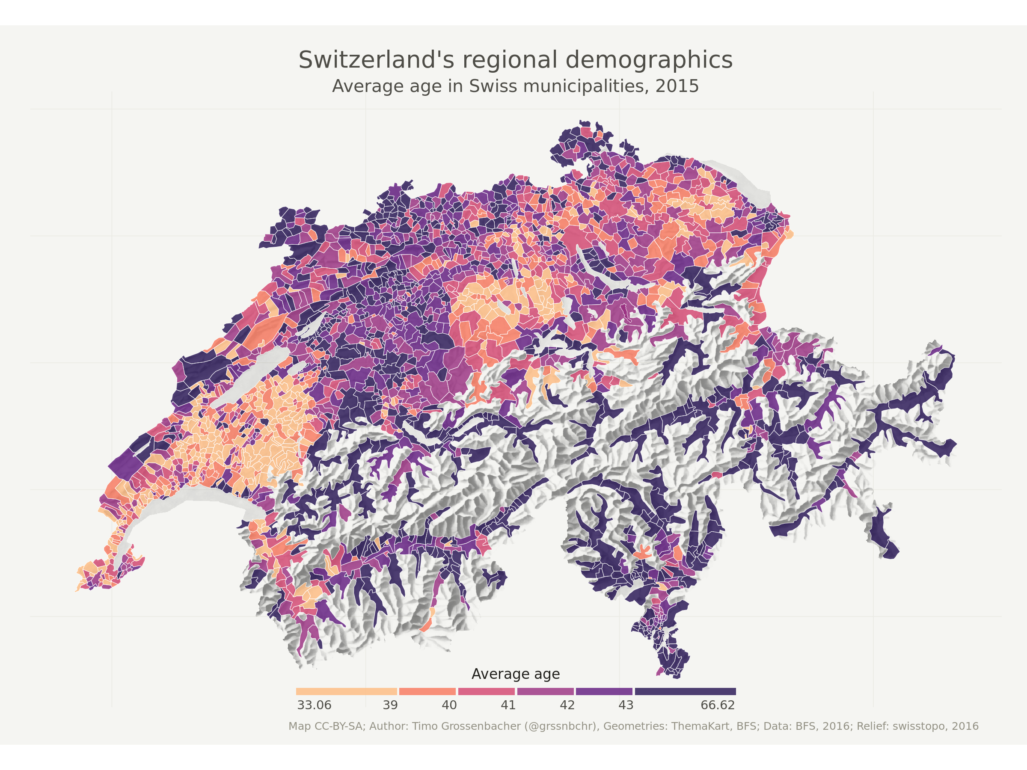
Mapping
Fundamentals
Layout and formatting
Color palettes
Create and customize examples
Continuous
Categorical

Slide 50
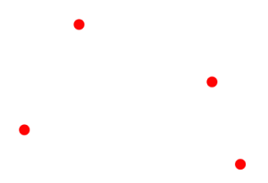
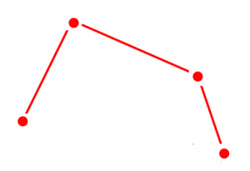
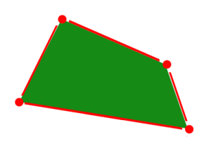
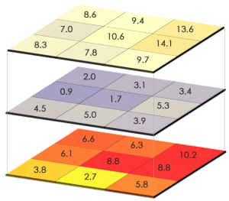
Fundamentals – spatial data types
Vectors
Points (cities, landmarks)
Lines (roads, rivers)
Polygons (country borders)
Raster
Points
Lines
Polygon

Slide 51
Fundamentals – data prep → plot
sf package (spatial features)
Load data
Shapefiles
Data to display
Join data of interest to shapefile

Slide 52
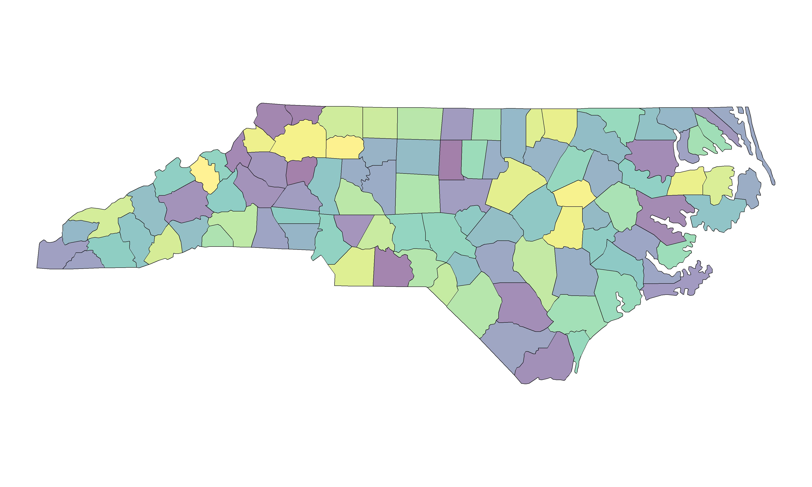
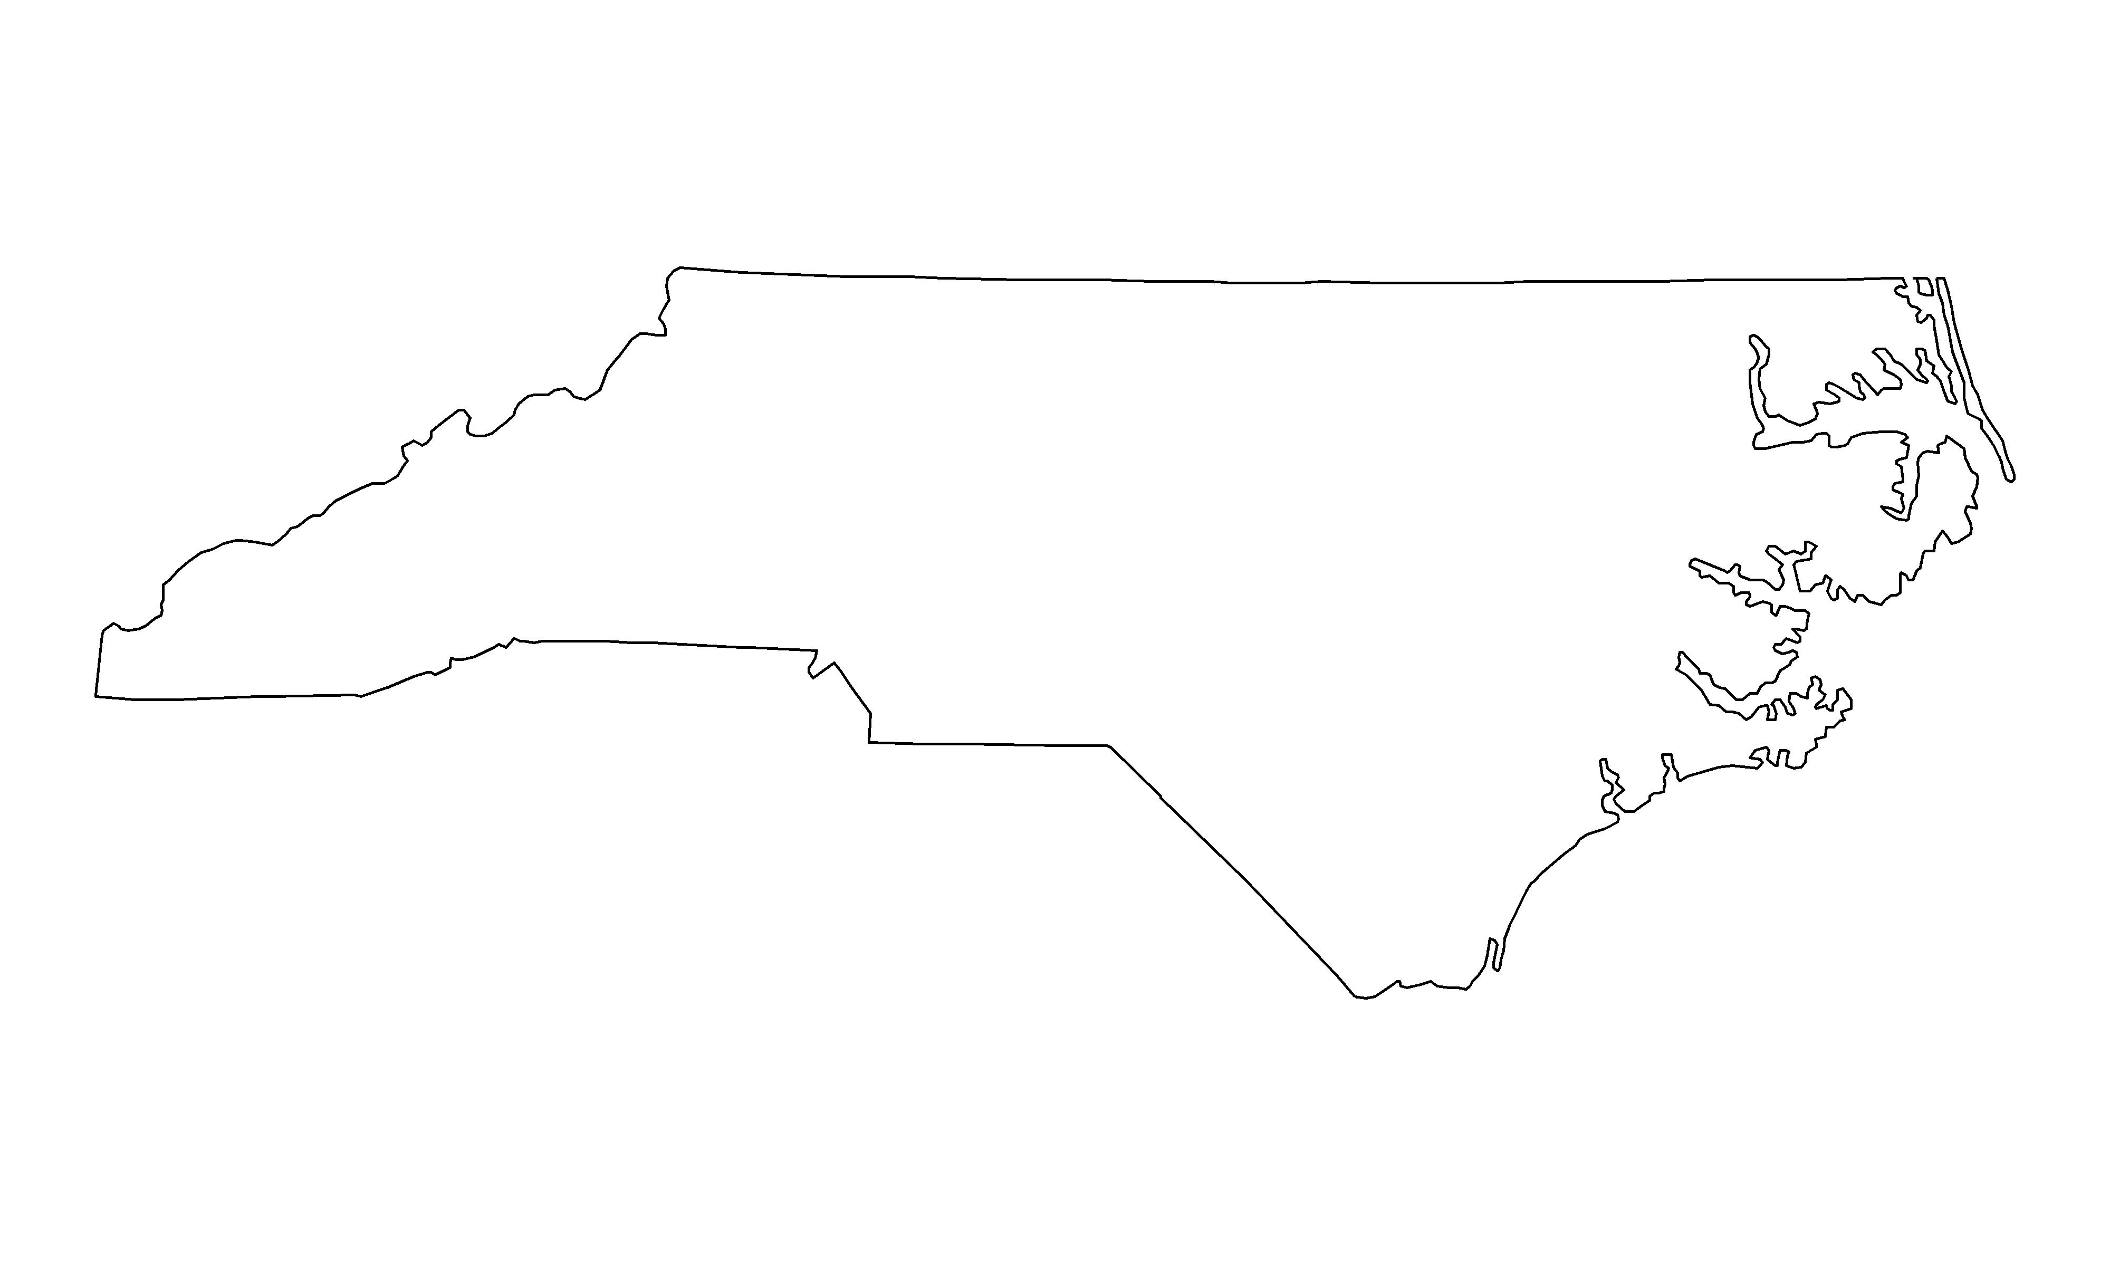
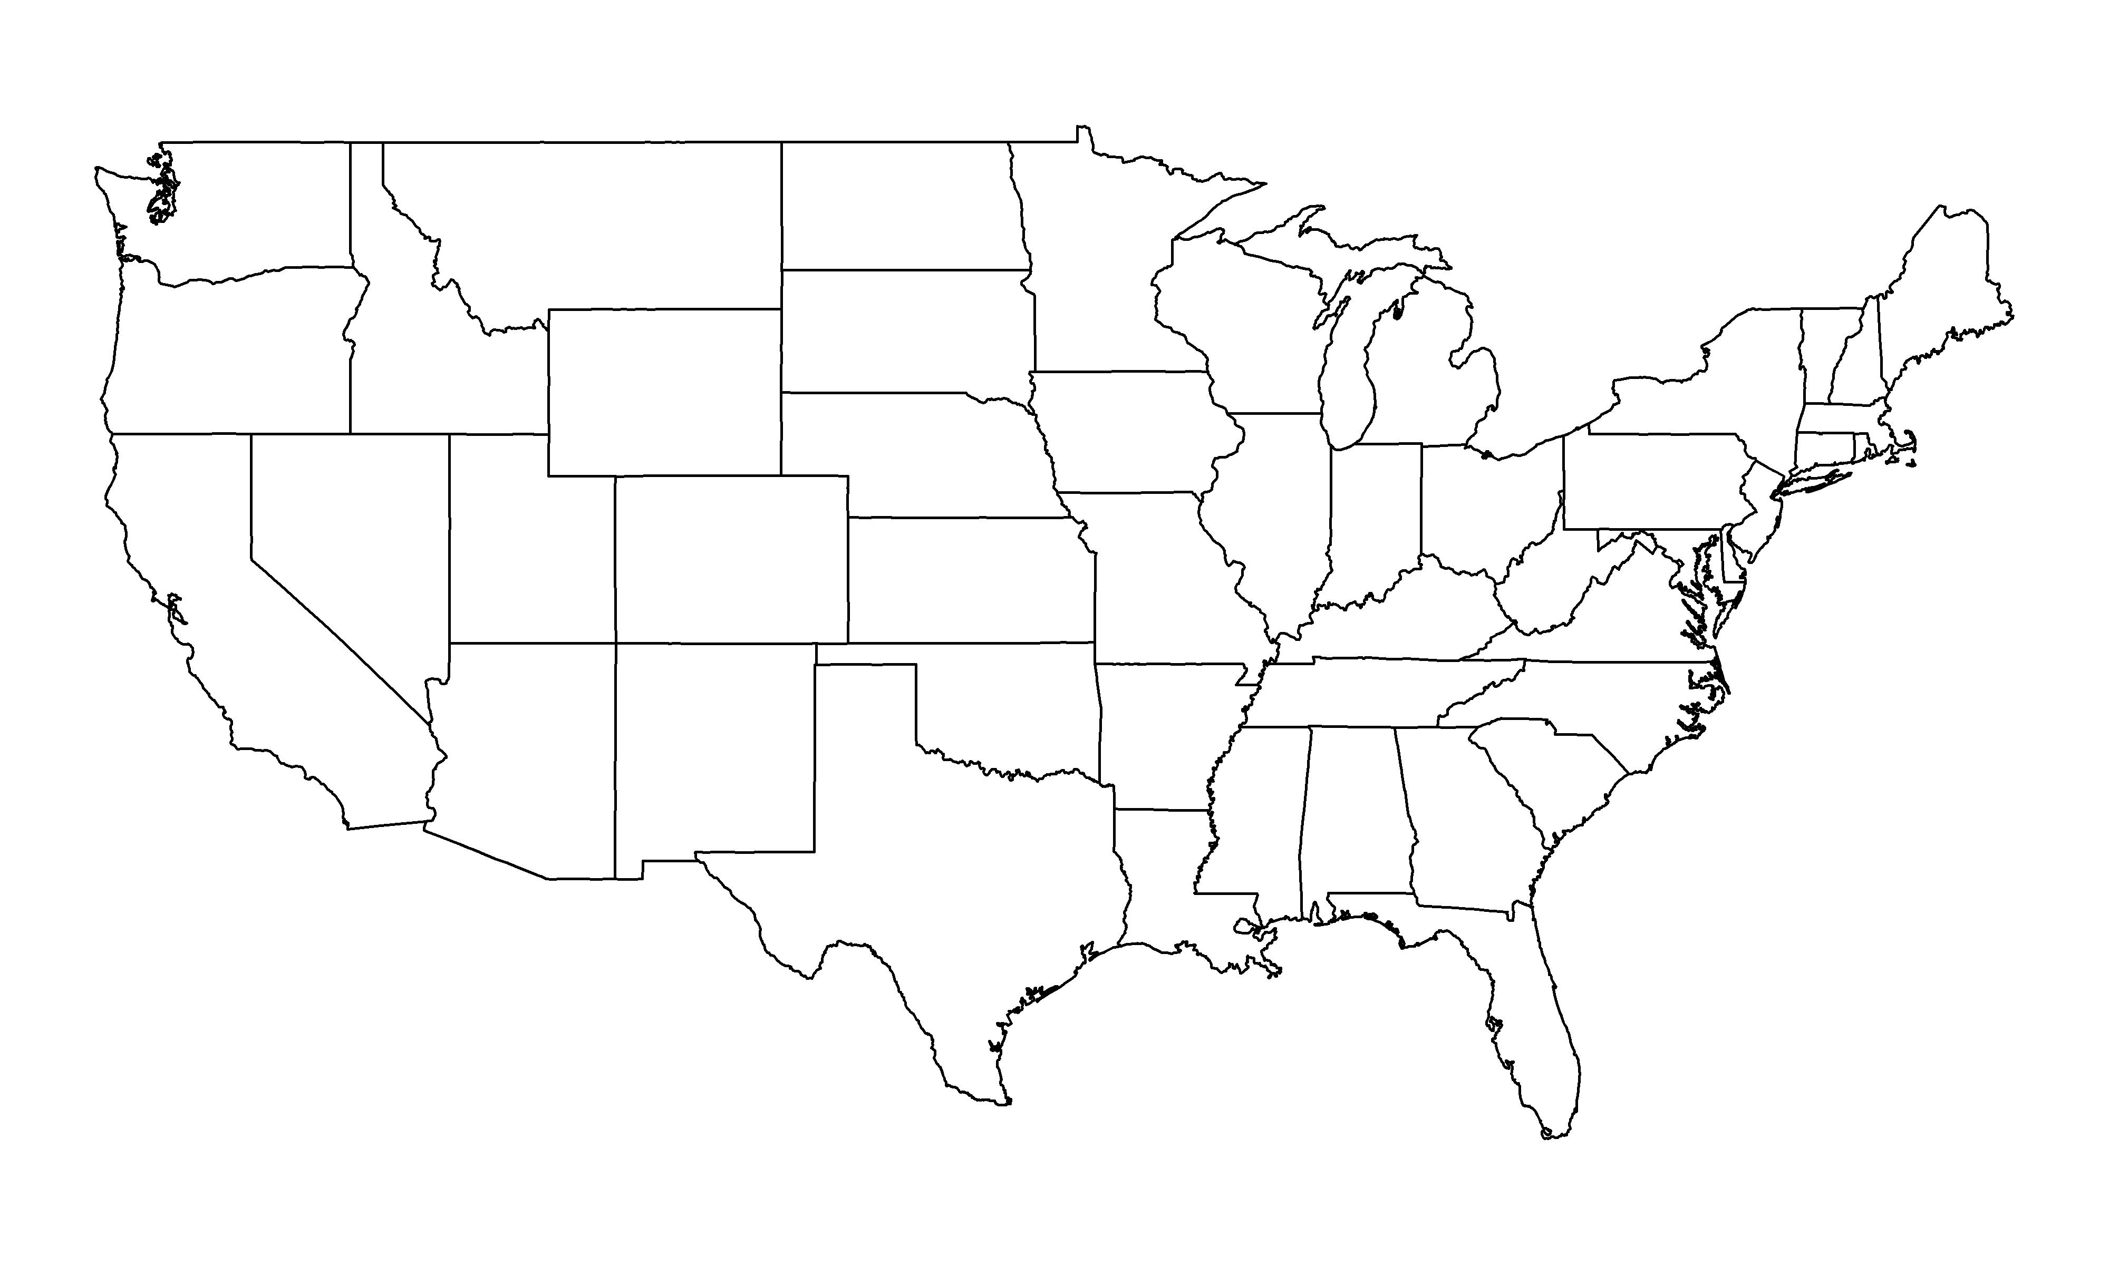
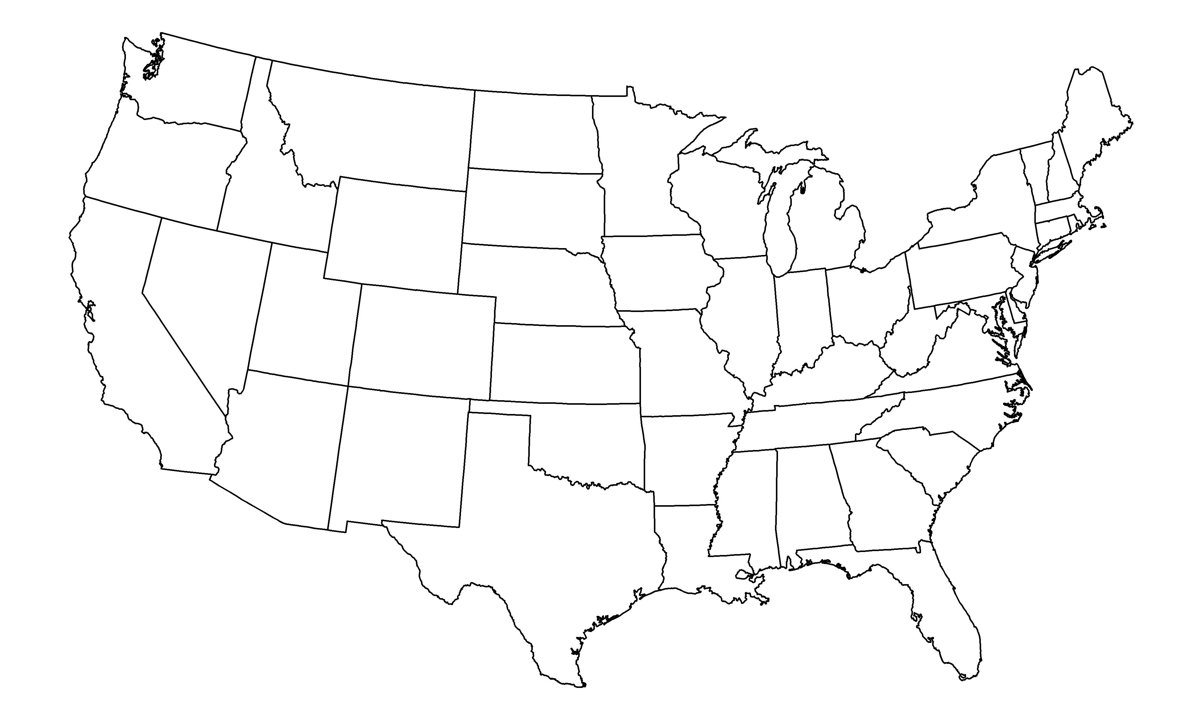
Fundamentals – data prep → plot
Geometry order is important!
Consider map projection
Cylindric
Conic

Slide 53

Choropleth example US counties
Data
Spatial wildfire occurrence data for the United States
County-level counts of fires (2008 and 2009)
Source: USDA Forest Service
Prepare data
Load shapefiles for state and county boundaries
Some packages have shapefiles for certain geographies (maps)
Manually load, st_read()
Combine with data of interest
Improvements
Adjust focus to map, background adjustment
Projection
Color palette
Line colors and thickness
Facet

Slide 54
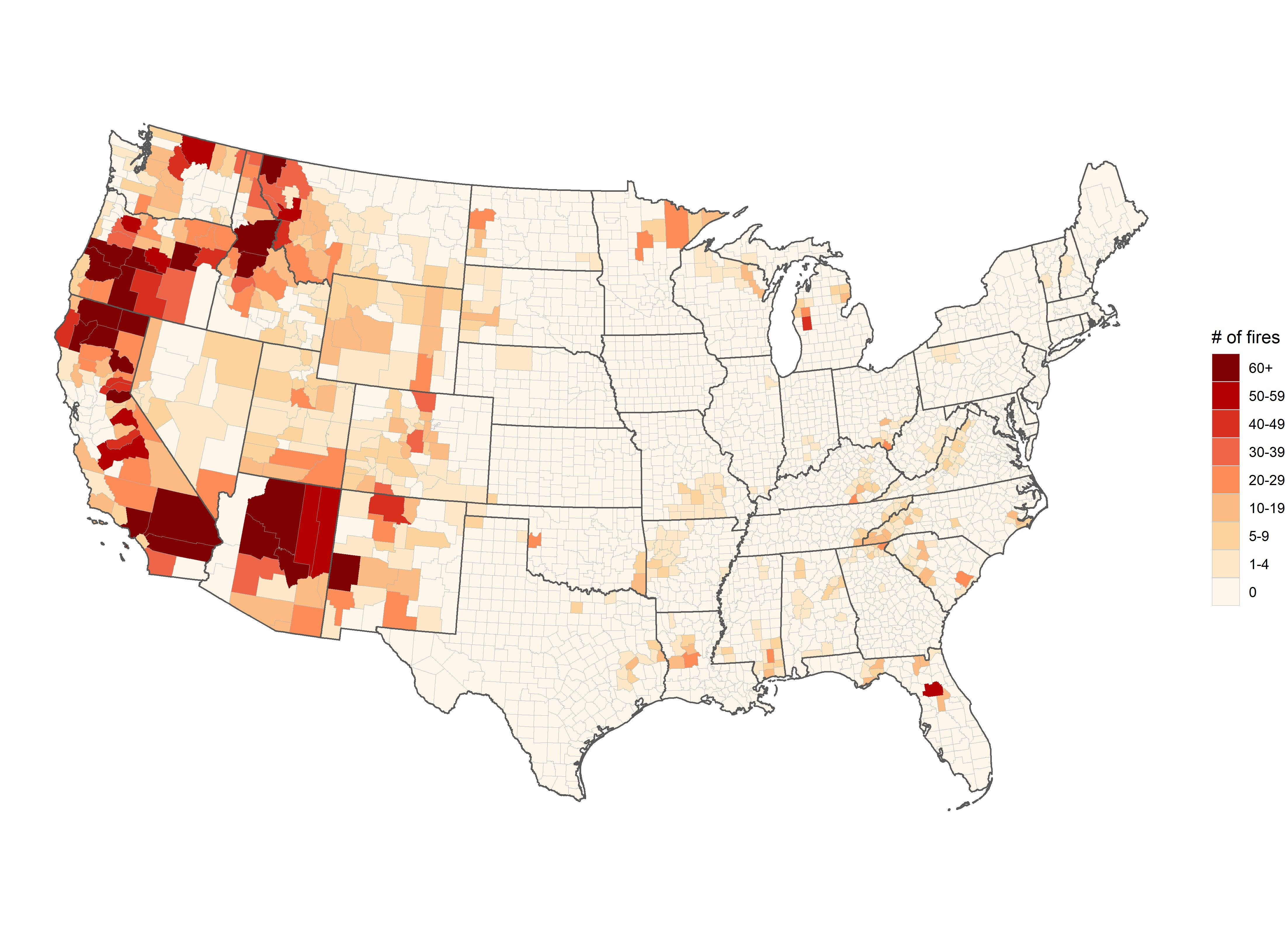
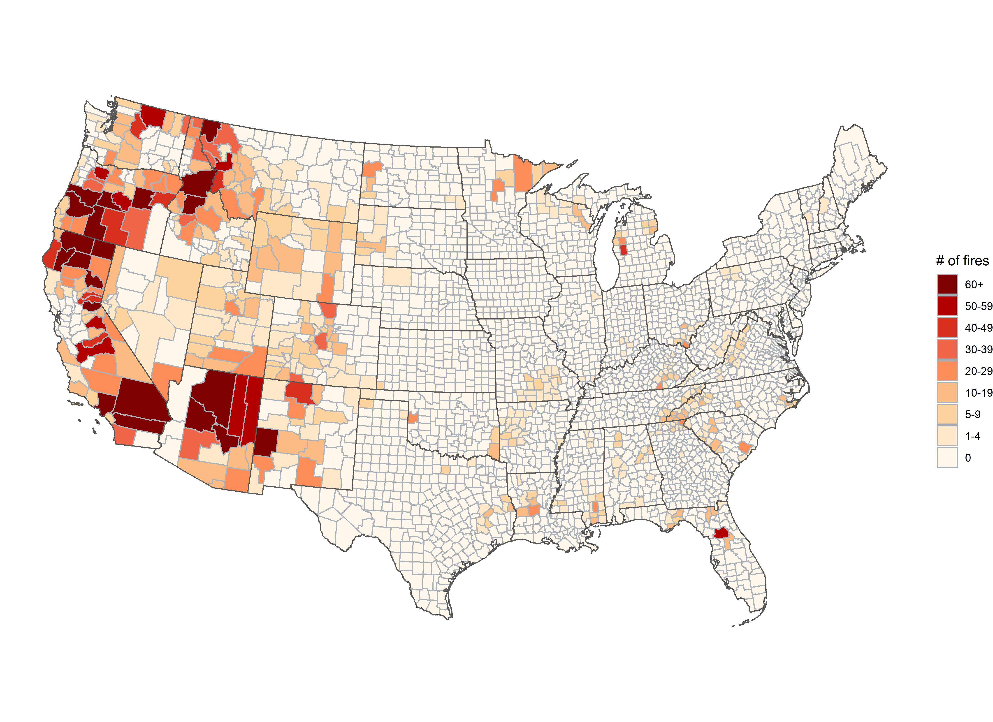
Reducing county line size

Slide 55
References

Slide 56
References
Pederson TL. ggplot2 Workshop [Internet]. Copenhagen: GitHub; 2020 [updated 2020 March 25; cited 2020]. Available from: https://github.com/thomasp85/ggplot2_workshop.
Peng RD and Dominici F. Statistical Methods for Environmental Epidemiology with R: A Case Study in Air Pollution and Health. New York: Springer-Verlag; 2008. Available from: https://www.springer.com/gp/book/9780387781662
R Studio. Data Visualizations with ggplot2 Cheat Sheet [Internet]. Boston: R Studio; 2020 [updated 2015 March; cited 2020]. Available from: https://rstudio.com/wp-content/uploads/2015/03/ggplot2-cheatsheet.pdf
Scherer C. A ggplot2 Tutorial for Beautiful Plotting in R [Internet]. 2019 [updated 2019 November 1; cited 2020]. Available from: https://cedricscherer.netlify.app/2019/08/05/a-ggplot2-tutorial-for-beautiful-plotting-in-r/
Wickham H. ggplot2: Elegant Graphic for Data Analysis. New York: Springer-Verlag; 2009. Available from: https://ggplot2-book.org/
Wilkinson L. The Grammar of Graphics. 2nd ed. New York: Springer-Verlag; 2005. Available from: https://www.springer.com/gp/book/9780387245447
ZevRoss. Beautiful plotting in R: A ggplot2 cheatsheet [Internet]. Ithaca: ZevRoss; 2014 [updated 2016 January 20; cited 2020]. Available from: http://zevross.com/blog/2014/08/04/beautiful-plotting-in-r-a-ggplot2-cheatsheet-3/

Slide 57
References for Data
United States Environmental Protection Agency (US EPA). National Air Quality: Status and Trends of Key Air Pollutants, Air Quality Trends. Available from: https://www.epa.gov/air-trends. [Accessed 2020].
Institute for Health Metrics and Evaluation (IHME). United States Hypertension Estimates by County 2001-2009. 2013. Seattle, United States of America: Institute for Health Metrics and Evaluation (IHME). Available from: http://ghdx.healthdata.org/record/ihme-data/united-states-hypertension-estimates-county-2001-2009. [Accessed 2020].
U.S. Department of Agriculture, Forest Service, Rocky Mountain Research Station. Spatial wildfire occurrence data for the United States, 1992-2011 [FPA_FOD_20130422] (1st Edition) Data publication contains GIS data Author(s): Short, Karen C. Publication Year:2013. Available from: https://www.fs.usda.gov/rds/archive/Catalog/RDS-2013-0009. [Accessed 2020].
National Cancer Institute (NCI) and Centers for Disease Control and Prevention (CDC). State Cancer Profiles, Incidence Rate Tables. 2018. https://statecancerprofiles.cancer.gov/incidencerates/index.php. [Accessed 2020].
Centers for Disease Control and Prevention (CDC). National Environmental Public Health Tracking. 2018. https://www.cdc.gov/nceh/tracking/. [Accessed 2020].
Rdocumentation for "Epi"Package.
https://rdocumentation.org/packages/Epi/versions/2.44

Slide 58
References for Examples
St Sauver JL, Grossardt BR, Yawn BP, Melton LJ 3rd, Rocca WA. Use of a medical records linkage system to enumerate a dynamic population over time: the Rochester epidemiology project. Am J Epidemiol. 2011 May 1;173(9):1059-68. doi: 10.1093/aje/kwq482. Epub 2011 Mar 23.
Liu JC , Wilson A, Mickley LJ, Dominici F, Ebisu K, Wang Y, Sulprizio MP, Peng RD, Yue X, Son JY, Anderson GB, Bell ML. Wildfire-specific Fine Particulate Matter and Risk of Hospital Admissions in Urban and Rural Counties. Epidemiology. 2017 Jan;28(1):77-85. doi: 10.1097/EDE.0000000000000556.
Sanders NJ, Barreca AI, Neidell MJ. Estimating Causal Effects of Particulate Matter Regulation on Mortality. Epidemiology. 2020 Mar;31(2):160-167. doi: 10.1097/EDE.0000000000001153.
Pun VC, Kazemiparkouhi F, Manjourides J, Suh HH. Long-Term PM2.5 Exposure and Respiratory, Cancer, and Cardiovascular Mortality in Older US Adults. Am J Epidemiol. 2017 Oct 15;186(8):961-969. doi: 10.1093/aje/kwx166.
Sidney S, Quesenberry CP Jr, Jaffe MG, Sorel M, Go AS, Rana JS. Heterogeneity in national U.S. mortality trends within heart disease subgroups, 2000-2015. BMC Cardiovasc Disord. 2017 Jul 18;17(1):192. doi: 10.1186/s12872-017-0630-2.
Wang B, Eum KD, Kazemiparkouhi F, Li C, Manjourides J, Pavlu V, Suh H. The impact of long-term PM2.5 exposure on specific causes of death: exposure-response curves and effect modification among 53 million U.S. Medicare beneficiaries. Environ Health. 2020 Feb 17;19(1):20. doi: 10.1186/s12940-020-00575-0.
Correia AW, Pope CA 3rd, Dockery DW, Wang Y, Ezzati M, Dominici F. Effect of air pollution control on life expectancy in the United States: an analysis of 545 U.S. counties for the period from 2000 to 2007. Epidemiology. 2013 Jan;24(1):23-31. doi: 10.1097/EDE.0b013e3182770237.

